Slide 1
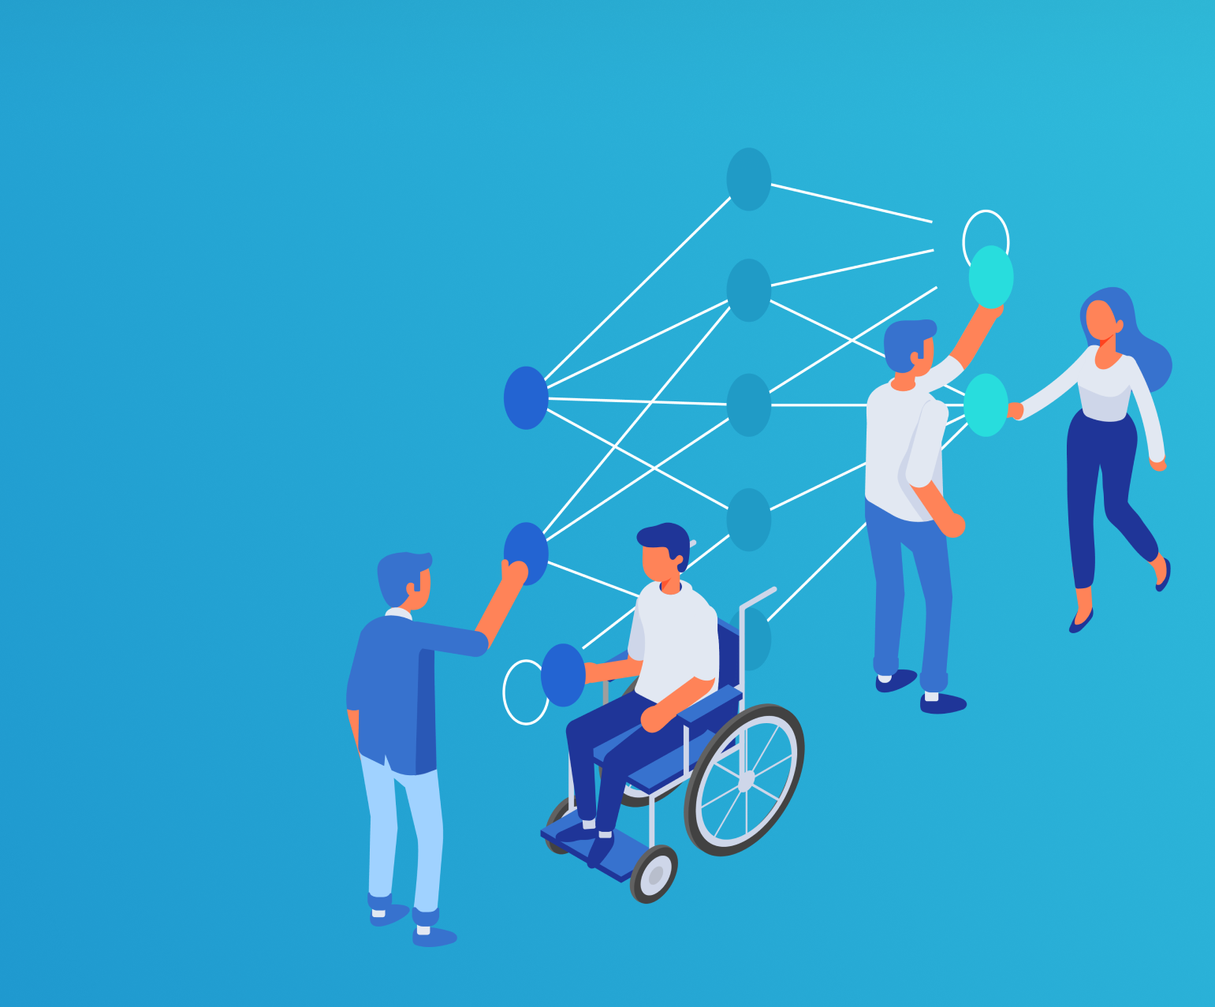
Responsible ML: Protecting privacy and preserving confidentiality in machine learning and data analytics
Sarah Bird
Principal Program Manager, Azure AI
Notes:
today, I’m excited to share the latest developments in our machine learning fairness toolkit called Fairlearn which take steps towards enabling to build fairer and more inclusive machine learning models

Slide 2


Tools and Technology
Customers
Understand
Protect
Control

Slide 3
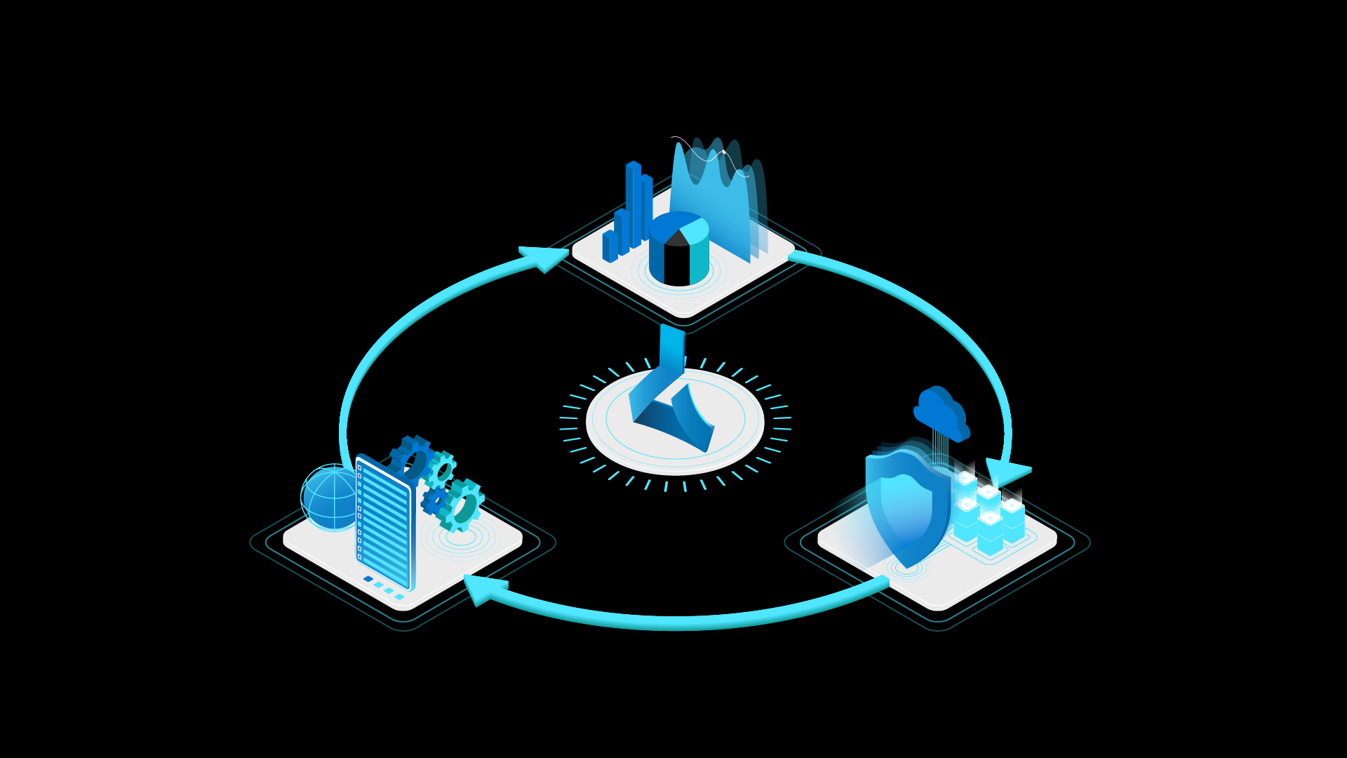
Understand
Interpretability
Fairness
Azure Machine Learning
Responsible ML
Control
Protect
Audit trail
Datasheets
Differential privacy
Confidential machine learning

Slide 4
Protect People and Data
Notes:
© Microsoft Corporation. All rights reserved. MICROSOFT MAKES NO WARRANTIES, EXPRESS, IMPLIED OR STATUTORY, AS TO THE INFORMATION IN THIS PRESENTATION.

Slide 5
How do I protect privacy while using data?
Notes:
WhiteNoise, an open source platform, has been co-developed with researchers in Harvard’s institute for Quantitive Social Sciences and the Privacy Tools Project. The project will be the first system launched as part of the nascent OpenDP initiative. The goal is to create a suite of open source capabilities that make it easy for many people to implement differential privacy in their applications. MAIDAP will be primarily contributing to this open source initiative

Slide 6
Differential Privacy
Notes:
© Microsoft Corporation. All rights reserved. MICROSOFT MAKES NO WARRANTIES, EXPRESS, IMPLIED OR STATUTORY, AS TO THE INFORMATION IN THIS PRESENTATION.

Slide 7

Hides the contribution of the individual

Slide 8
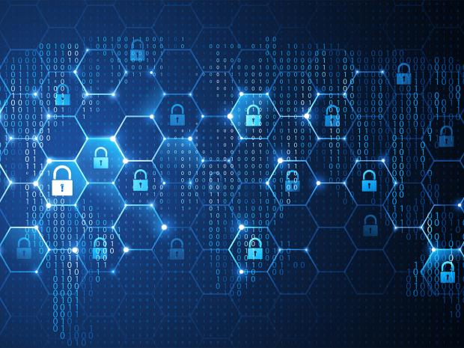


Differential Privacy (DP)
DP is a class of algorithms that facilitate computing and releasing aggregate statistics from sensitive (private) data, while ensuring that privacy is not compromised.
Definition: A randomized algorithm $A$ satisfies $ε$-DP, if for all databases $D$ and $D′$ that differ in data pertaining to one user, and for every possible output value $Y$:
Privacy budget.
Pool of private data
DP statistics:
Noisy. Noise conceals contributions of individual users
Can be safely handed to an all-powerful adversary, with no risk of a privacy leak
Aggregate statistics
DP algorithm
$$\operatorname{Pr}\left[A\left(D\right)=Y\right]≈_{ε}\operatorname{Pr}\left[A\left(D′\right)=Y\right].$$

Slide 9
How Differential Privacy Works
Add Noise
Track Budget
Notes:
WhiteNoise, an open source platform, has been co-developed with researchers in Harvard’s institute for Quantitive Social Sciences and the Privacy Tools Project. The project will be the first system launched as part of the nascent OpenDP initiative. The goal is to create a suite of open source capabilities that make it easy for many people to implement differential privacy in their applications. MAIDAP will be primarily contributing to this open source initiative

Slide 10





Differential Privacy for Machine Learning and Analytics
Native Runtime
C,C++, Python, R
Privacy Budget
Control queries by users
Data Source Connectivity
Data Lakes, SQL Server, Postgres, Apache Spark, Apache Presto and CSV files
Validator
Automatically stress test DP algorithms
https://github.com/opendifferentialprivacy
Notes:
WhiteNoise, an open source platform, has been co-developed with researchers in Harvard’s institute for Quantitive Social Sciences and the Privacy Tools Project. The project will be the first system launched as part of the nascent OpenDP initiative. The goal is to create a suite of open source capabilities that make it easy for many people to implement differential privacy in their applications. MAIDAP will be primarily contributing to this open source initiative

Slide 11
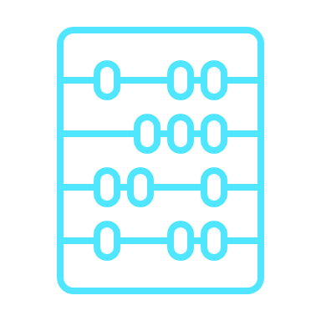

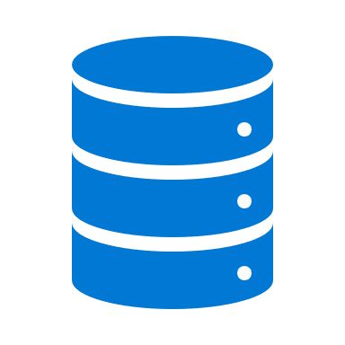


Privacy Module
Checks budget and private compute
Dataset checks budget and access credentials
Budget Store
Private data
Submits a query
BUDGET
Mechanism adds noise
Receives a differentially private report
User
Report
Private Dataset
Credentials to access the data
https://github.com/opendifferentialprivacy
Notes:
WhiteNoise, an open source platform, has been co-developed with researchers in Harvard’s institute for Quantitive Social Sciences and the Privacy Tools Project. The project will be the first system launched as part of the nascent OpenDP initiative. The goal is to create a suite of open source capabilities that make it easy for many people to implement differential privacy in their applications. MAIDAP will be primarily contributing to this open source initiative

Slide 12

OpenDP
A community effort to build a trustworthy and open-source suite of differential privacy tools that can be easily adopted by custodians of sensitive data to make it available for research and exploration in the public interest.

Slide 13
Unlock Data
Notes:
WhiteNoise, an open source platform, has been co-developed with researchers in Harvard’s institute for Quantitive Social Sciences and the Privacy Tools Project. The project will be the first system launched as part of the nascent OpenDP initiative. The goal is to create a suite of open source capabilities that make it easy for many people to implement differential privacy in their applications. MAIDAP will be primarily contributing to this open source initiative

Slide 14
Confidential Machine Learning
Notes:
© Microsoft Corporation. All rights reserved. MICROSOFT MAKES NO WARRANTIES, EXPRESS, IMPLIED OR STATUTORY, AS TO THE INFORMATION IN THIS PRESENTATION.

Slide 15

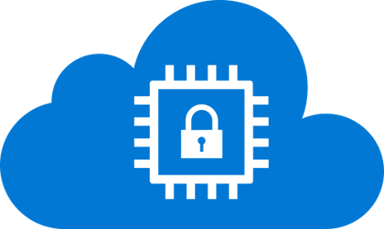
Confidential ML Technologies
Privacy Barrier
Privacy Barrier
Confidential from Data Scientist
Encrypted using Hardware

Slide 16
Homomorphic Encryption
Notes:
© Microsoft Corporation. All rights reserved. MICROSOFT MAKES NO WARRANTIES, EXPRESS, IMPLIED OR STATUTORY, AS TO THE INFORMATION IN THIS PRESENTATION.

Slide 17
Homomorphic Encryption
Homomorphic encryption allows certain computations to be done on encrypted data, without requiring any decryption in the process:
Decrypt(Encrypt(A) + Encrypt(B)) = A + B
Decrypt(Encrypt(A) * Encrypt(B)) = A * B
Different from classical encryption like AES or RSA:
Privacy Barrier

Slide 18
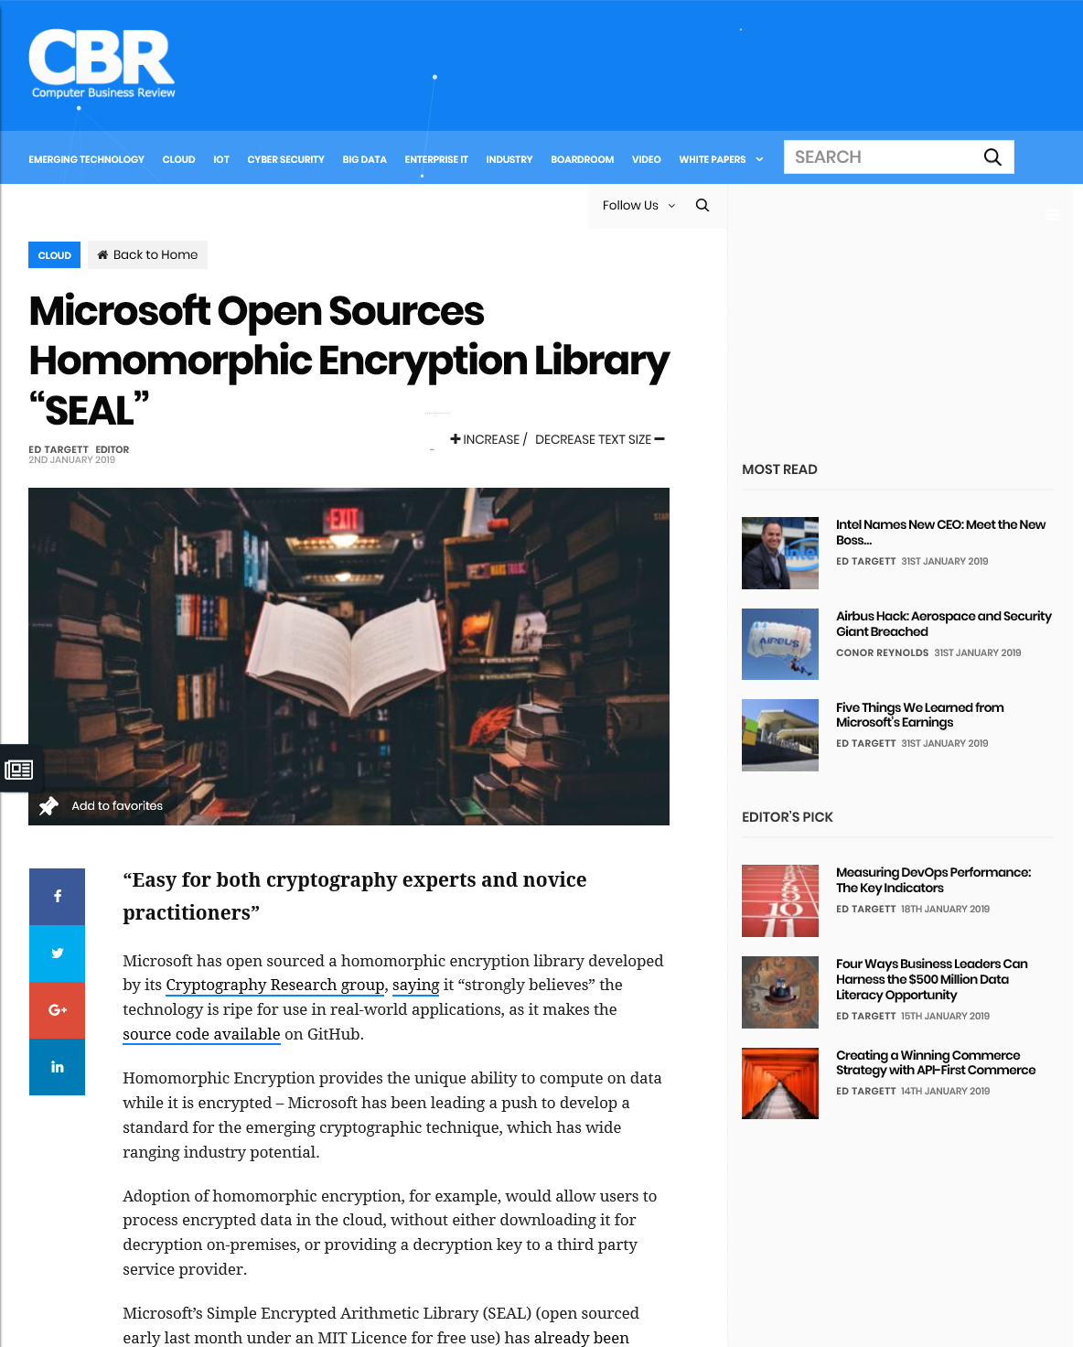
Microsoft SEAL
Open-source homomorphic encryption library
Developed actively since 2015
Recently released v3.5
Available at GitHub.com/Microsoft/SEAL
Supports Windows, Linux, macOS, Android, FreeBSD
Written in C++; includes .NET Standard wrappers for public API
From open source community:
PyHeal (Python wrappers from Accenture)
node-seal (JavaScript wrappers)
nGraph HE Transformer (from Intel)

Slide 19
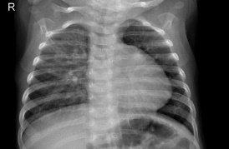
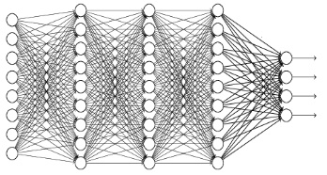
Private Prediction on Encrypted Data
Privacy Barrier [cryptographic]
Through a trained machine learning model, private prediction enables inferencing on encrypted data without revealing the content of the data to anyone.
Microsoft SEAL can be deployed in a variety of applications to protect users personal and private data
Medical prediction

Slide 20
Responsible ML Resources
Microsoft Responsible AI Resource Center
https://aka.ms/RAIresources
Azure Machine Learning
https://azure.microsoft.com/en-us/services/machine-learning/
https://docs.microsoft.com/en-us/azure/machine-learning/concept-responsible-ml
OpenDP
http://opendp.io/
https://twitter.com/opendp_io
OpenDP System
https://github.com/opendifferentialprivacy
https://docs.microsoft.com/azure/machine-learning/concept-differential-privacy
https://docs.microsoft.com/azure/machine-learning/how-to-differential-privacy
SEAL
https://github.com/Microsoft/SEAL
https://docs.microsoft.com/azure/machine-learning/how-to-homomorphic-encryption-seal
https://aka.ms/SEALonAML

